Slide 1
Virtual Reality Shopping Experience for Blind Assistance and Development
Developed
P.Sivakumar 811221104035
S.Vishwa 811221104048
S.M.Bharathkumar 811221104002
Project Supervisor
Dr.A.vivek Ignatius
Assistant Professor
Department of Computer Science and Engineering

Slide 2
ABSTRACT
This project aims to provide a Virtual Reality (VR) shopping experience tailored to assist visually impaired individuals. The system enables users to explore products virtually through audio-based navigation, voice commands, and object recognition. Using Flask for web development, Open CV for vision processing, and MySQL for data storage, the application creates an accessible online shopping environment where blind users can browse and select products effortlessly.

Slide 3
INTRODUCTION
Traditional online shopping platforms are not user-friendly for visually impaired individuals due to complex navigation, lack of accessibility features, and dependency on screen readers. This project introduces a VR-based solution that enhances accessibility through voice-assisted navigation and AI-driven product identification.

Slide 4
OBJECTIVES
To develop a VR-integrated shopping platform accessible to visually impaired users. To implement audio-based product recognition for a seamless shopping experience. To integrate Flask-based web development with MySQL for user and product data management. To ensure real-time interaction using voice commands and camera-based object detection.

Slide 5
PROPOSED SYSTEM
The proposed system allows visually impaired users to navigate through a virtual shopping environment using speech input and real-time object recognition. The system is built using: Flask for handling web-based interactions. Open CV & MediaPipe for detecting products and user interactions. MySQL for storing product information and user preferences. Voice commands for product selection and purchase confirmation. Users can scan barcodes, recognize product labels, and receive voice-guided assistance while browsing products in the virtual space.

Slide 6
SYSTEM ARCHITECTURE
The system consists of:1. User Interface (UI): Voice-assisted product navigation.
Backend: Flask framework handling user requests.
Database: MySQL storing product details and user data.
Computer Vision Module: Open CV & MediaPipe for recognizing objects/products.
Voice Processing Module: Converts text to speech for blind user interaction.

Slide 7
ALGORITHM
Initialize System – Start the Flask server, connect to MySQL, and activate the camera.
Detect Products – Capture real-time video, process frames using OpenCV & MediaPipe.
Recognize Objects – Compare detected objects with the product database (protb).
Voice Assistance – Convert product details into speech output using Text-to-Speech (TTS).
User Interaction – Listen for voice commands (e.g., "Add to Cart," "Remove from Cart").
Shopping Cart Management – Update the cart in the database based on user input.
Admin Controls – Allow admin to add, update, or remove products in real time.

Slide 8
MODULES
User Authentication: Secure login system using Flask.
Product Recognition: Object detection via OpenCV & MediaPipe.
Voice Assistance: Speech-based product selection.
Shopping Cart: Users can add/remove products via voice commands.
Admin Dashboard: Admins can manage product details and user information.
Real-Time Camera Integration: Users can scan product barcodes for additional details.

Slide 9
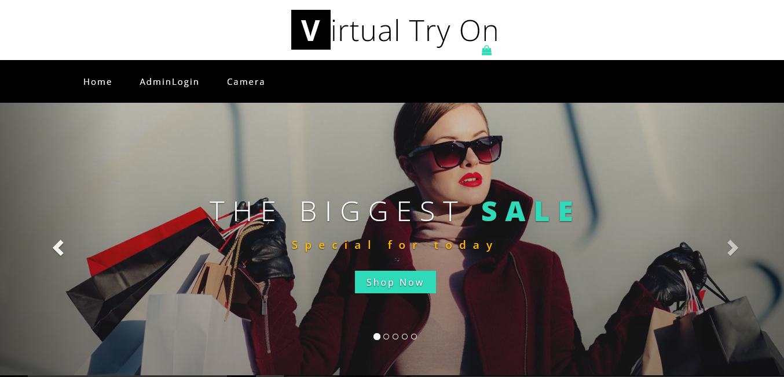
SCREENSHOTS

Slide 10
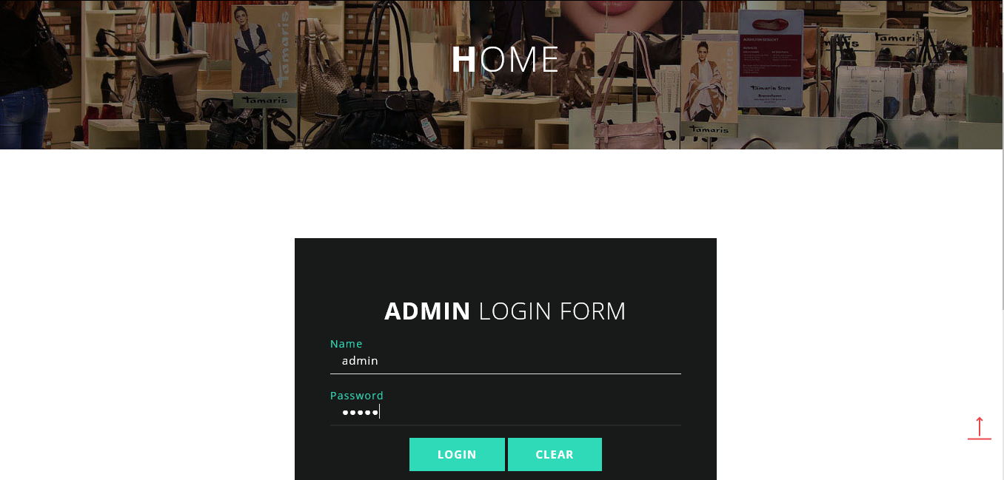

Slide 11
CONCLUSION
The Virtual Reality Shopping System enhances accessibility for visually impaired users, allowing them to shop independently through audio feedback and real-time object detection. The integration of Flask, OpenCV, and MySQL ensures an efficient and scalable platform. Future improvements may include AI-powered voice assistants and smart payment options to further enhance usability

Slide 12
REFERENCES
Research Papers & Journals
Hussein M., Ibrahim M. & Farag H, (2021)."Assistive Technologies for Visually Impaired Users in E-commerce: A Review "International Journal of Human-Computer Interaction. [DOI: 10.1080/10447318.2021.1902986]
2. Mishra A & Sharma P, (2020)."A Smart Virtual Shopping Assistant for the Visually Impaired "IEEE Transactions on Consumer Electronics, Vol. 66, No. 3, pp. 234-245. [DOI: 10.1109/TCE.2020.2998754]
3. Sharma R & Patel K, (2019)."Integrating AI and Computer Vision for Enhanced Online Shopping Accessibility "International Journal of Computer Vision and Artificial Intelligence.
Technical Documentation & Books
4. Flask Web Development: Developing Web Applications with Python – Miguel Grinberg (O'Reilly Media, 2nd Edition, 2018)
5. OpenCV with Python: Computer Vision & AI Applications – Adrian Rosebrock (PyImageSearch, 2020)
6. Speech and Language Processing – Jurafsky & Martin (Pearson, 3rd Edition, 2021)
Online Resources & Websites
7. OpenCV Documentation – https://docs.opencv.org/
8. Flask Framework Official Docs – https://flask.palletsprojects.com/
9. MySQL Documentation – https://dev.mysql.com/doc/

